Slide 1

Project Title - Seasonal Agriculture Performance Analysis
Student Name : Ann Mary Rifna M J
College Name : Mar Athanasius College of Engineering , Kothamangalam
AICTE STU ID : STU6a69c27e0bba61785315966

Slide 2

Problem Statement
Agricultural performance varies depending on seasonal conditions, environmental factors, farming practices, resource usage, and market conditions. However, raw agricultural data does not clearly show how these factors affect crop production, resource efficiency, and economic performance.
The problem is to analyze agricultural data across different seasons, regions, crops, and farming conditions to identify meaningful patterns, trends, relationships, and variations. The analysis can help understand differences in yield, production, water usage, costs, revenue, and profit across seasons.

Slide 3
Project Description
Seasonal Agriculture Performance Analysis is a data analytics project that studies agricultural performance across different seasons, geographical regions, crops, environmental conditions, resource usage, and economic factors. The project involves cleaning and preparing the agricultural dataset, performing exploratory data analysis, comparing different seasons and crop categories, and identifying relationships between environmental conditions and agricultural outcomes.
The analysis focuses on parameters such as: Crop and season ,Farm area, Rainfall ,Average temperature, Humidity ,Sunlight hours ,Seed quality ,Crop yield and production ,Market price ,Total cost ,Revenue and profit ,Water usage and water efficiency ,Disease/pest risk
The final objective is to generate data-driven insights and recommendations that can support better seasonal agricultural planning. This follows the project's stated objective of identifying patterns, trends, relationships, and differences in agricultural performance.

Slide 4

Who Are The End Users?
Farmers – to understand which seasons and conditions may provide better crop performance and resource efficiency.
Agricultural planners – to support seasonal crop planning and resource allocation.
Agricultural researchers – to study relationships between environmental conditions and agricultural outcomes.
Government and agricultural departments – to support evidence-based agricultural policies and planning.
Data analysts and students – to practice real-world agricultural data analysis and visualization.

Slide 5

Technology Used
  Python
  Pandas
  NumPy
  Matplotlib
  Seaborn

Slide 6
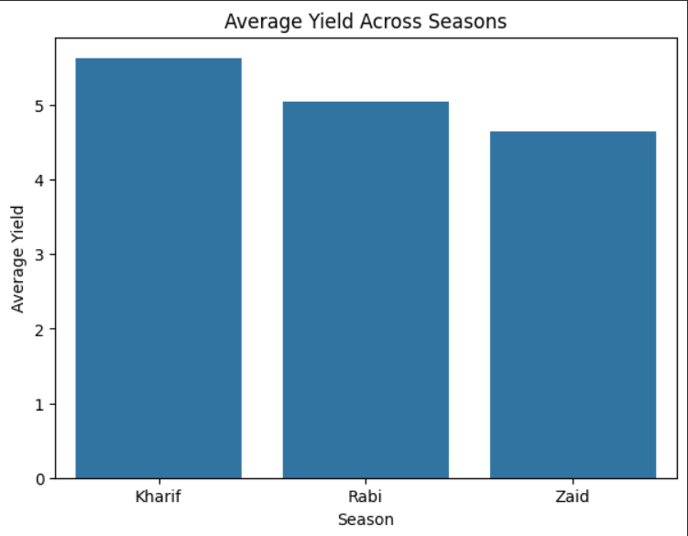
Results
Kharif recorded the highest average yield (5.6 tonnes/ha), followed by Rabi (5.1 tonnes/ha) and Zaid (4.7 tonnes/ha). This indicates noticeable seasonal variation in agricultural yield, with Kharif showing the best average performance.

Slide 7
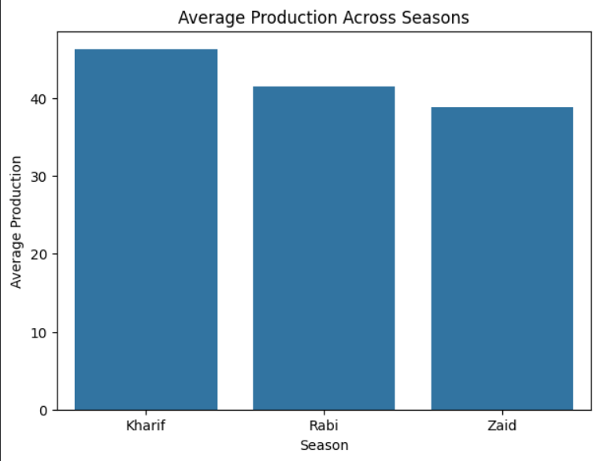
Results
Average production varies across seasons. Kharif records the highest average production at approximately 46.3 tonnes, followed by Rabi at 41.5 tonnes, while Zaid records the lowest at 38.9 tonnes. This indicates that the seasonal pattern observed in yield is also reflected in overall agricultural production

Slide 8
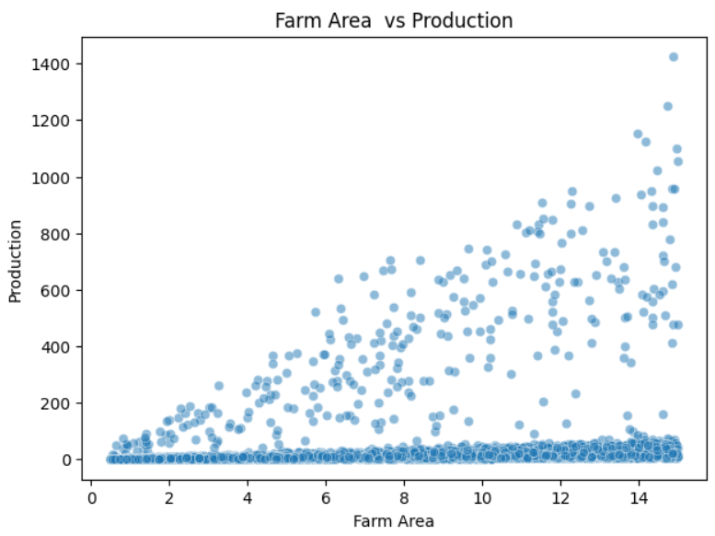
Results
Larger farms tend to have higher production, although considerable variation exists among farms of similar sizes. This suggests that farm area contributes to production

Slide 9
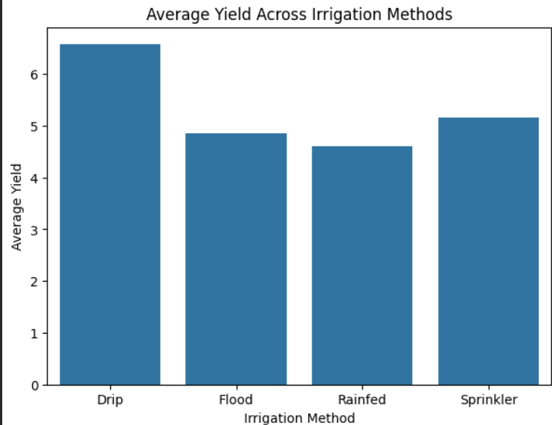
Results
Drip irrigation records the highest average yield at approximately 6.6 tonnes/ha, while rainfed agriculture records the lowest at around 4.6 tonnes/ha. Sprinkler and flood irrigation show intermediate average yields. This suggests that irrigation method is associated with differences in agricultural yield

Slide 10
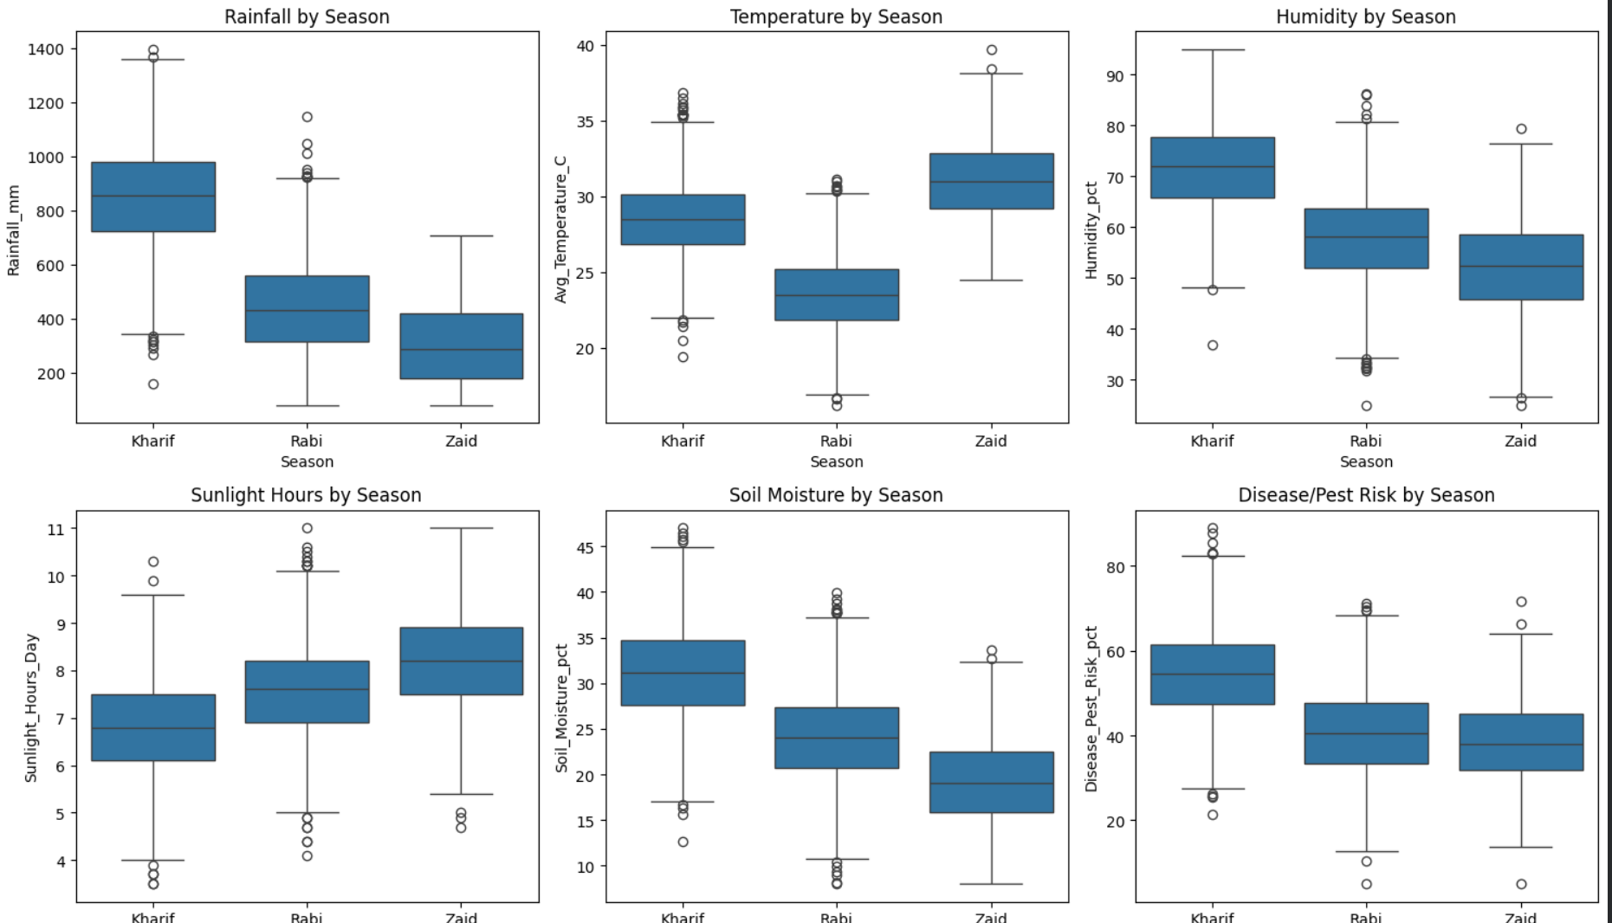
Results
Significant seasonal variations are observed in environmental conditions. Kharif has the highest rainfall, humidity, soil moisture, and disease/pest risk, while Zaid has the highest temperature and sunlight hours and the lowest rainfall and soil moisture. Rabi generally shows intermediate conditions.

Slide 11
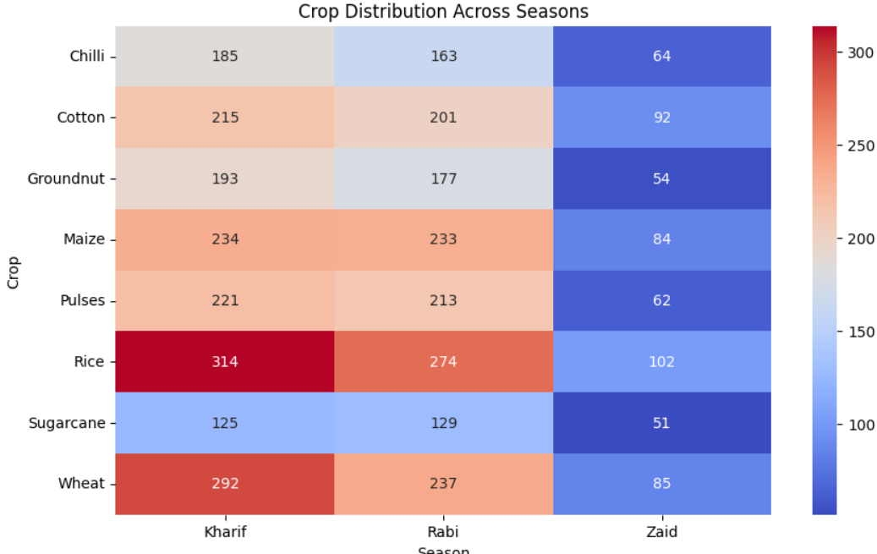
Results
Agricultural activities vary across both crop type and season. Kharif and Rabi have substantially more crop observations than Zaid. Rice has the highest representation across all seasons, while Sugarcane has comparatively fewer observations.

Slide 12
Future scope
The project can be extended beyond descriptive and exploratory analysis in several ways:
Crop yield prediction – build machine-learning models to predict yield based on rainfall, temperature, humidity, soil/environmental conditions, seed quality, etc.
Profit prediction – estimate expected revenue, cost, and profit before cultivation.
Crop recommendation – recommend suitable crops based on seasonal and environmental conditions.
etc..

Slide 13
GitHub Link
https://github.com/annmaryrifna/Data-Analysis/tree/main/Seasonal%20Agriculture%20Performance%20Analysis

Slide 14
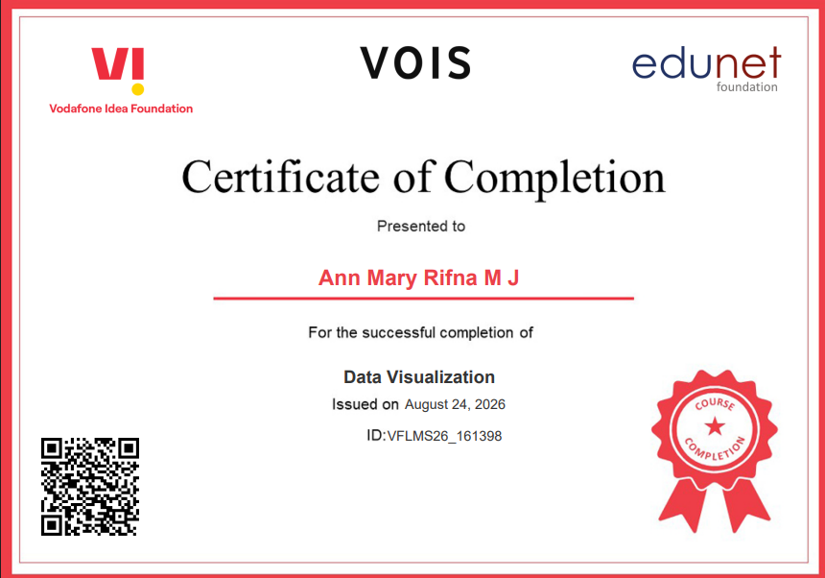
VOIS Course completion certificate -
Course name- Data Visualization

Slide 15
Thank you
.
.

